Slide 1



Telecommunications engineering Cycle
Graduation Project Presentation
Unipd mobility
« Fixed complexity tiny reservoir
heterogeneous network for on-line ECG
learning of anomalies»
Academic Supervisors:
Prof. Mourad Zghal
Prof. Gian Antonio Susto
Presented by:
Norhen Abdennadher
Company Supervisors:
Mr. Danilo Pau
Mr. Arcangelo Bruno
Academic Year 2020 - 2021

Slide 2
Outline
01
Hosting Organization
05
  Experimental Results
02
Project scope
06
Complexity analysis
03
Dataset and preparation process
07
  Conclusion & future work
04
  Proposed network architecture

Slide 3

1
Host Organisation
3

Slide 4
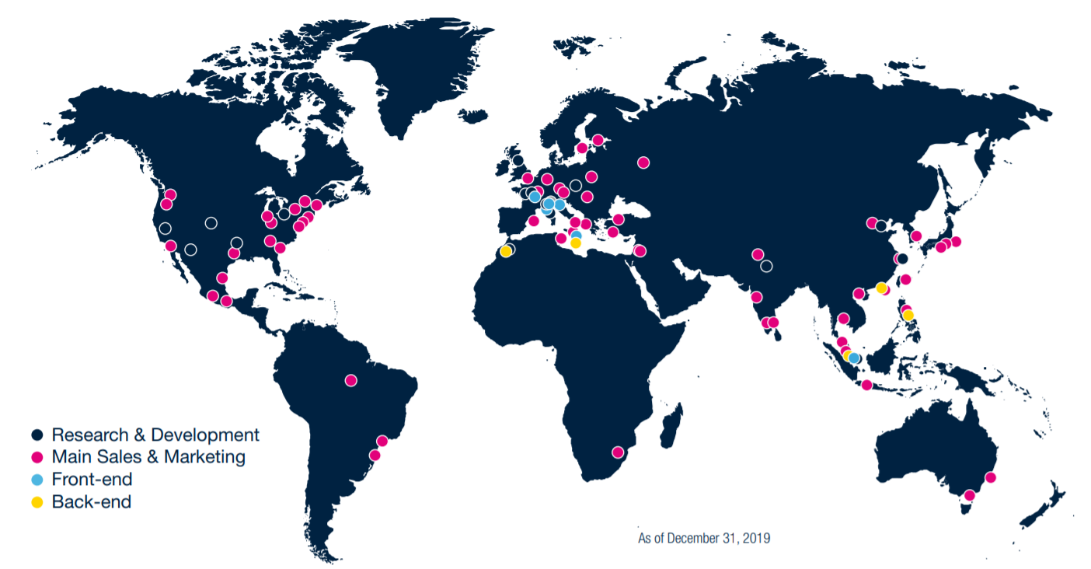
1. Host organization
STMicroelectronics is a global leader company, established in 1987, serving customers
across the spectrum of electronics applications with innovative semiconductor solutions.
ST global presence:
ST vision:
ST stands for
Everywhere microelectronics
make a positive contribution to people’s lives, ST is there
Notes:
I’ve got the opportunity to work within STM microelectronics italy for 6 months now as a research and development intern. STM is global leader company in providing innovative semiconductor solutions. It was named the sixth-most respected firm among semiconductor businesses in the world. ST has a worldwide network of front- end and back-end plants. And its aim is to make a positive contribution to people’s life.

Slide 5
1. Host organization
STMicroelectronics strategy stems from key long-term enablers:
Support the
use of renewable energy sources.
Increase energy
efficiency everywhere,
Green technologies.
Power & Energy
Sector of
activity
Making everyday things
smarter, connected
and more aware
of their surroundings.
Connected, digital, electric vehicles.
Making driving safer, greener.
5G and IoT
Smart Mobility
Notes:
If we look at the ST sector of activity we can notice that it can be devided into 3 fields. The first trend is Power and energy ST technology and solutions enable customers to increase energy efficiency everywhere & support the use of renewable energy sources.
The second trend is Smart mobility: ST provides innovative solutions to help customers make driving safer, greener and more connected for everyone.
And the 3rd trend is Internet of things & 5G: ST provides sensors, embedded processing, connectivity, security and power management.

Slide 6
2
Project scope
3
Notes:
Let’s move now to the 2 nd part of the presentation to expose the main purpose of the performed work.

Slide 7



2. Project scope
Cardiovascular diseases
According to the world health organization(WHO), Cardiovascular diseases are the number 1 cause of death globally, taking an estimated 17.9 million lives each year.
31%
of all global deaths
Cardiovascular diseases
More people die annually from CVDs than from any other cause.
Sex specific risk factors
Well established risk factors
Under-recognized risk factors
Notes:
Do you know that while we’re talking now, 150000 (1hundred 50 thousand) people in average are dying now around the world, 31% from the daily death is caused by Cardiovascular diseases.
In fact according to the world health organization, CVDs are the leading cause of death globally. The main risks behind these diseases can be divided into 3 factors : sex specific risk factor, well established risk factors and under recognized risk factors.

Slide 8






2. Project scope
Electrocardiogram & arrhythmia detection
The electrocardiogram (ECG) signal reflects the electrical activity of the heart.
Arrhythmia detection from ECG recordings is performed by cardiologists.
Highest error rates of interpretation
Notes:
Dealing with cardiovascular diseases has been studied over years in order to detect several pathological diseases at an early stage. As we all know a quick interventions may lead to better outcomes and even save lives in most of the times. Electrocardiography (ECG), which monitors the electrical activity of the heart, can actually detect several pathological diseases at an early stage.
However, to do so it would be necessary to carry out continuous health monitoring over extended periods of time. Until now this has been impractical for different reasons. First of all, long-term surveillance generates large amounts of data, most of which are probably non-anoumalous or normal. Also, searching such abnormalities must be performed by qualified and trained cardiologists, which is really time consuming, and it leads to highest rates of interpretations.
Also, one of the major challenges to detect anomalies is set by the consideration that a normal heartbeat varies with age, body size, activity, and emotions. For this reason, an automated ECG arrhythmia detection has received much interest in the past few years. So let’s explore in the next slide the proposed solution.

Slide 9














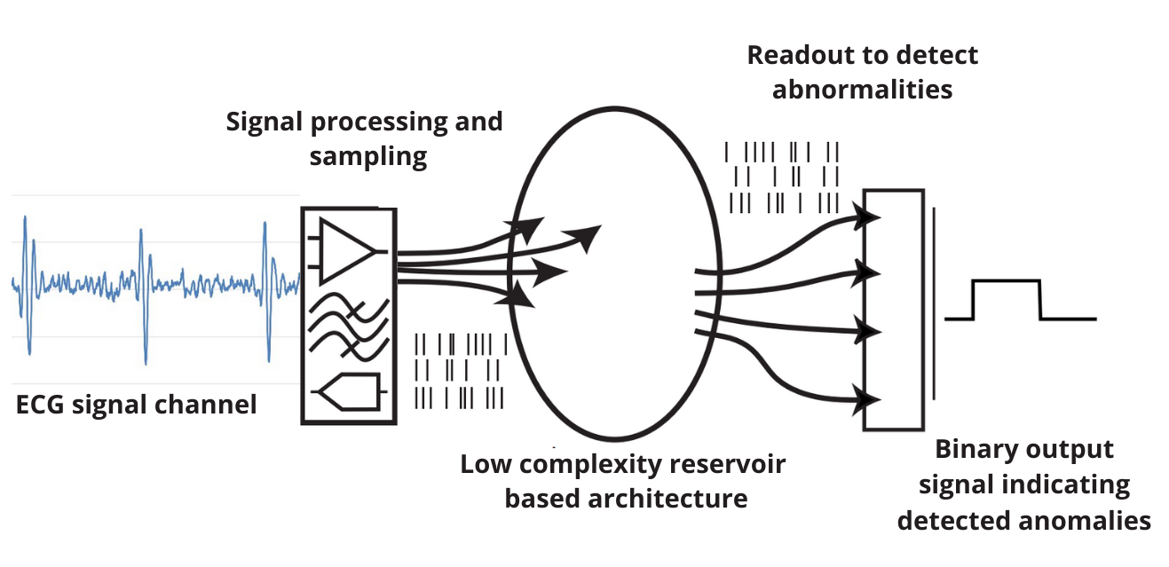
2. Project scope
Objectives
Detect anomalies
Online
Limited amount of normal data for training
Real-time
Personalized learning
Providing adequate performances
Implementable on a low-cost microcontroller
Notes:
The purpose of this project is to create an automated solution to detect anomalies using deep and machine learning, it consists of proposing an anomaly detector, always-on system, performing online and personalized learning of anomalies, using a limited amount of normal data, we can say the minimum amount of data possible to provide adequate performances. This solution must be of low complexity in order to be possibly implementable on a low power microcontroller.

Slide 10
3
Dataset and preparation process
3

Slide 11

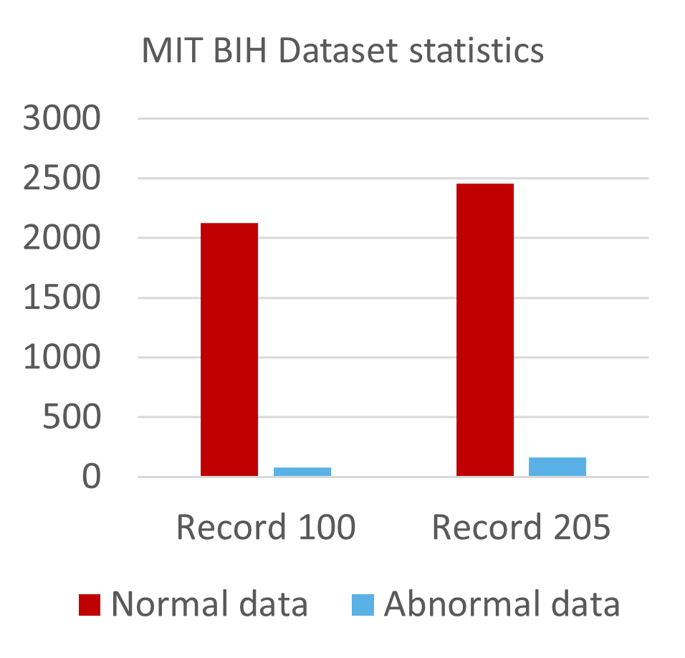
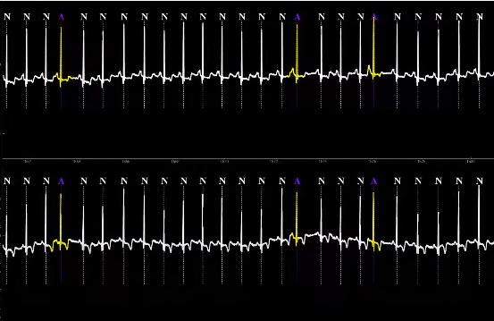
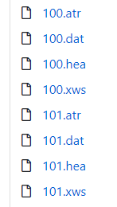
3. Dataset and preparation process
MIT BIH dataset
The MIT-BIH Database was the first set of standard test material to evaluate arrhythmia detectors.
48 half-hour records of two-channels with sampling frequency=360Hz
Unbalanced data
Annotated dataset
https://physionet.org/content/mitdb/1.0.0/
Notes:
In order to evaluate the proposed work, we worked with the MIT BIH dataset. It is the first set of standard test material that was publicly available to evaluate any arrhythmia detectors. This dataset consists of 48 records, each record is slightly over 30 minutes collected from different population males and females aged between 20 and 90. The ECG signal within this dataset is sampled with 360 Hz. Each record in this dataset is a very well annotated. Another characteristic of the MIT BIH dataset is that it is an unbalanced dataset which means that the number of normal data overpass the number of abnormal data.

Slide 12
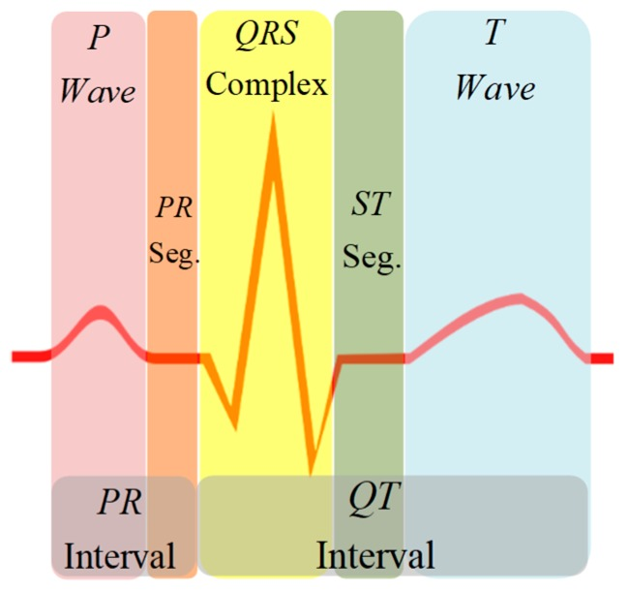
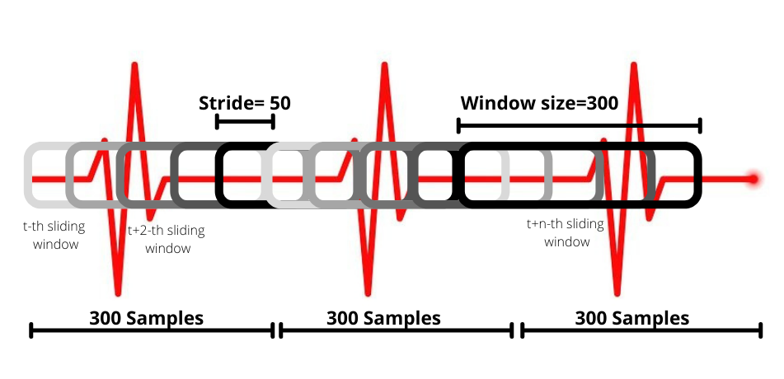
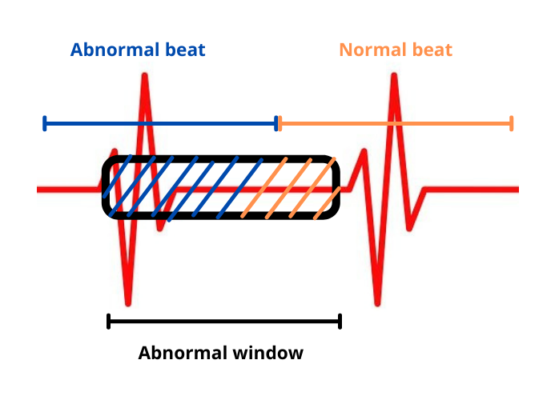
3. Dataset and preparation process
Preparation process
In the MIT BIH dataset, labels are placed around the R peak
Introduce a sliding window of size 300
and stride 50
Apply sliding window on data and labels set
Reannotate the derived windows of data
Record number | Training set | Test set
100 | (100,300,1) | (13414, 300, 1)
205 | (100,300,1) | (15616, 300, 1)
Split test and train data
Notes:
The MIT BIH dataset is originally considered as a segmented dataset which means each record is devided into individual heartbeats, and the labels are placed around the R peak. In real life scenarios, we cannot guarantee a prior knowledge about the heartbeat position and for this matter, we need to modify the dataset. We introduce a sliding window that will slide over the record, the size of this window is fixed to 300 samples which correponds approximately to the lenght of a heartbeat. The dataset was reannotated to mimic the temporal sliding of the datastream.

Slide 13
4
Proposed network architecture
3
Notes:
Let’s move on and talk about the hybrid deep and machine learning model.

Slide 14
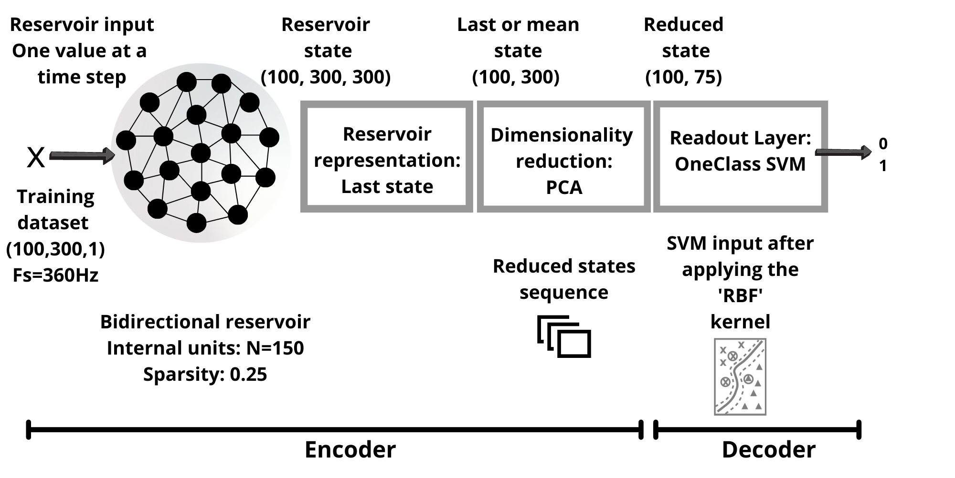
4. Proposed network architecture
Hybrid Reservoir Computing Machine Learning (HyRCoML)
The proposed architecture is a combination of four modules: a reservoir module, a representation module, a dimensionality reduction module, and a readout module.
Notes:
The proposed topology is called HyRCoML which stands for Hybrid Reservoir Computing Machine Learning. A classifier in AI is commonly expressed as a combination of an encoding and a decoding function, the encoder generates a compact representation of the input, while the decoder is a discriminative model that computes the desired output.
The proposed architecture is a combination of 4 modules: reservoir module, representation module, dimensionality reduction module and a readout module.

Slide 15
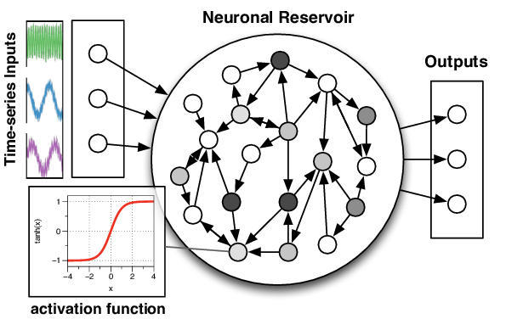
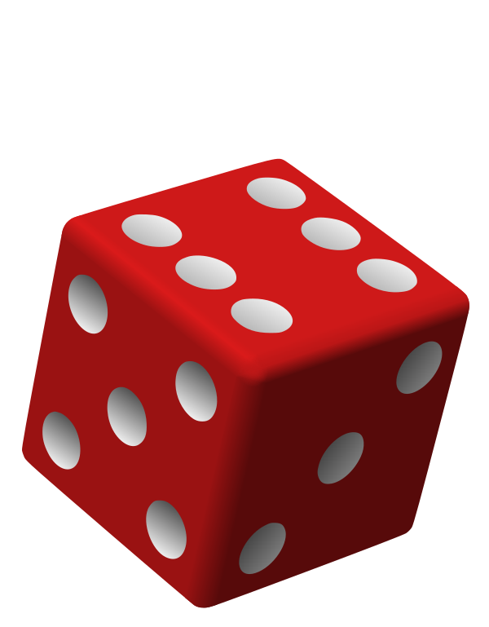
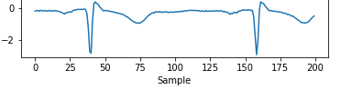
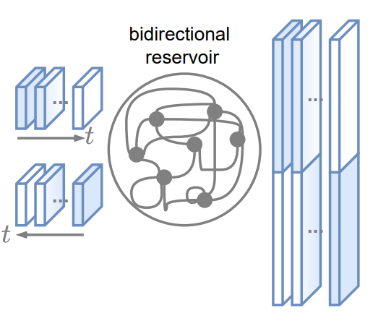
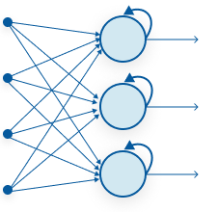
4. Proposed network architecture
Deep learning approch: Reservoir module
A reservoir computing is a derivation from recurrent neural network
Non trainable
weights Wr and Win
Randomly initialized and kept unchanged
ECG Time series
Data input
Bidirectional reservoir
Recurrent reservoir with 25% spasity
Getting the benefits of RNNs
Avoid costly operations (BPTT)
Avoid RNN’s problems
Notes:
The first module is the reservoir module. The basic idea behind a reservoir computing is to get the benefits of a RNN, but without the problem of training a traditional RNN like the costly operations behind Back propagation through time algorithm. The input of the reservoir is the ECG time series data. The input weights and recurrent weights of the reservoir are randomly assigned and kept untrained. The reservoir is bidirectional, it can capture longer time dependencies by summarizing at every step both recent and past information. And finally, the reservoir is sparse with 25% of sparsity.

Slide 16

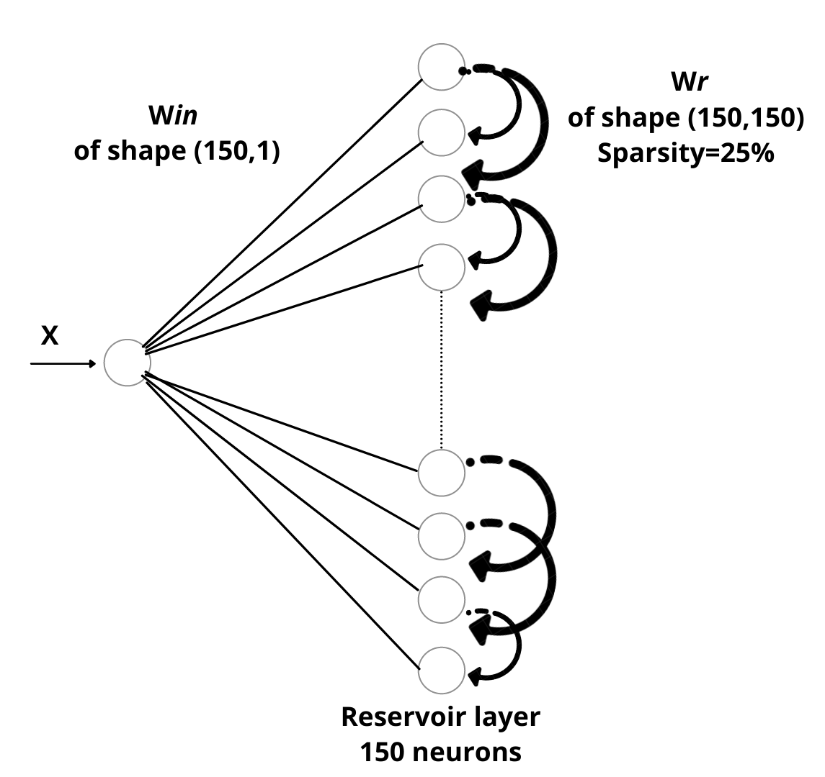
4. Proposed network architecture
Representation module
The representation module, is a function that maps all reservoir states to a representation state after feeding the whole time series at once.
Training set
Time series data
RC generates a representation of the TS input
Representation module takes the last or mean state
Shape of training set
(100,300,1)
Shape of reservoir state
(100,300,300)
Shape of reservoir
representation
(100,300)
Notes:
The reservoir module is followed by a representation module. After feeding the whole timeseries data at once, the reservoir computes a state for each input. The representation module is a function that picks either the last state or the mean state of the network. In this work, the presentation module picks the last state. This can be explained by an exemple: it’s like you are throwing a stone inside a lake, at the beginning you’ll see a chaos and water splashing everywhere and a after a certain time you can notice stable waves within the lake which is the last waves state.

Slide 17
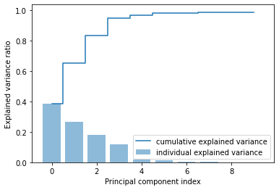
4. Proposed network architecture
Dimensionality reduction module
The dimensionality reduction module consists of projecting input representation from a high to a lower-dimensional space, usually relying on unsupervised criteria (PCA).
Reservoir computing module
Representation module
Dimensionality reduction module
PCA
Shape of reservoir state
(100,300,300)
Shape of the
reservoir representation
(100,300)
Shape of PCA
module output
(100,75)
0.3867647 | 0.6512681 | 0.8334442
0.9505576 | 0.9682135 | 0.9816600
Notes:
The representation module is followed by a dimensionality reduction module, which is PCA (principle component analysis). The dimension of the reservoir representation was reduced from (100,300) to (100,75). We can notice from the diagram that the first principle component accounts for 38% of the variance by itself, and jointly with the second principle component we can reach 65% of the variance. In this work the data was projected on 75 principle component which accounts for 99% of the variance.

Slide 18
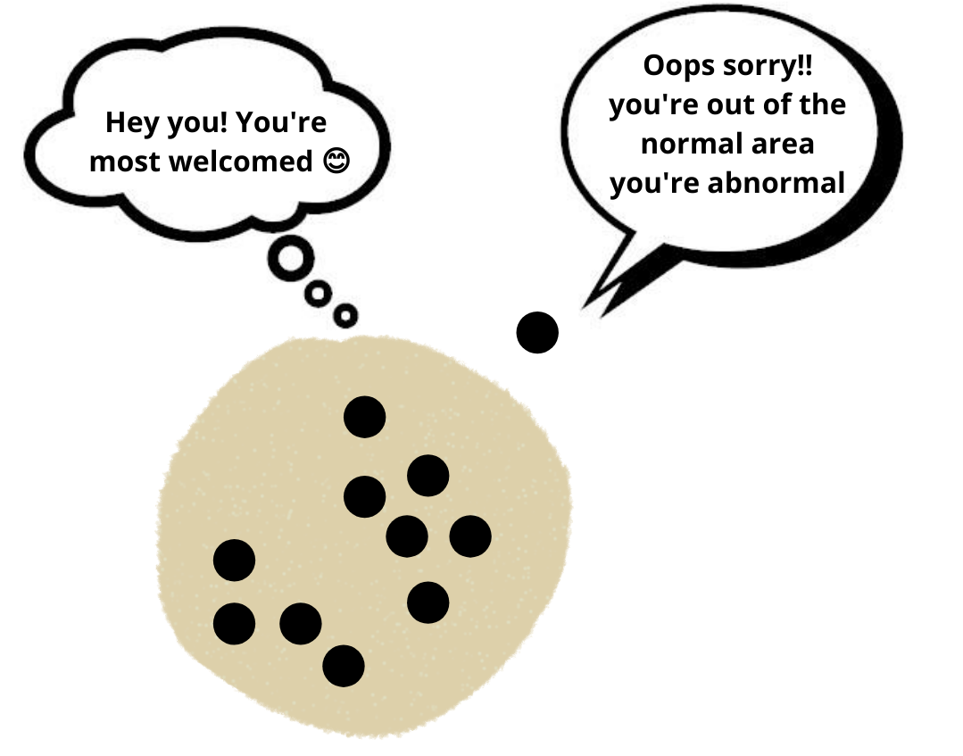
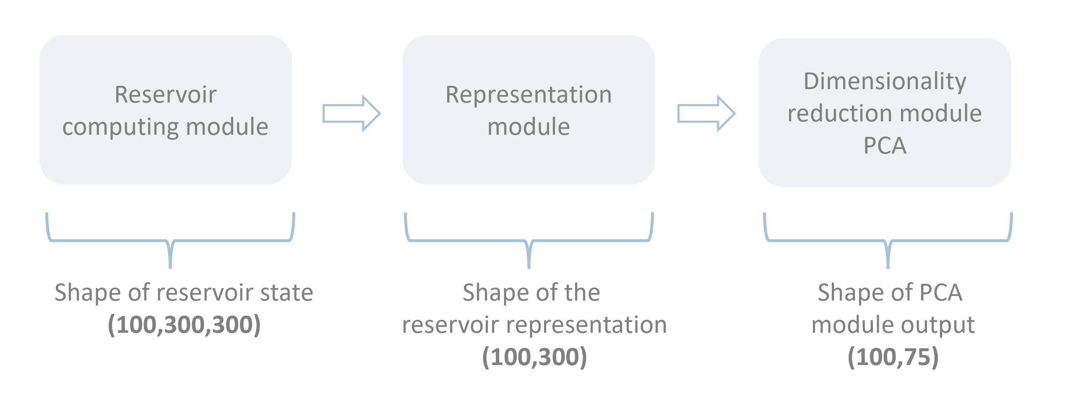
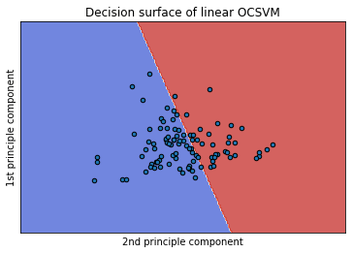
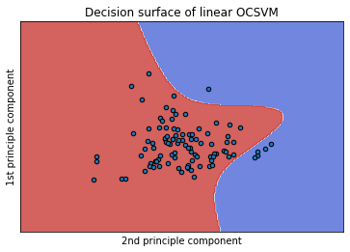
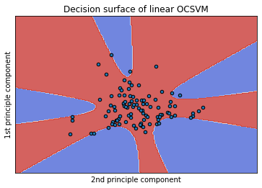
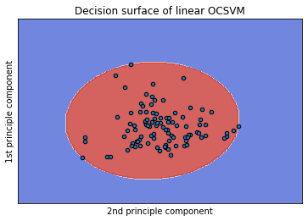
4. Proposed network architecture
One Class Support Vector Machine module
One Class SVM is an unsupervised learning algorithm that is trained only on ‘normal’ data.
One Class SVM module
0 Normal
1 Abnormal
OCSVM kernel function:
Linear kernel
Polynomial kernel (3)
Polynomial kernel (5)
RBF kernel
Notes:
We reached now the last module of our HyRCoML topology which is One Class support vector machine. OCSVM is an extension of SVM’s that performs a one class classification on unbalanced data. it uses a hypersphere to encompass all normal instances in the training set as we can see on the slide. If newly encountered data is too different, according to some measurement, it is labeled as abnormal. The main OCSVM hyperparameter is the kernel function that we can visualize its decision boundary on a plot if we project data into 2D data. There are 3 famous kernel functions for OCSVM. We can start by the linear kernel, as we can see it failed to encompass the data as it is far from the linear behaviour. Second the polynomial kernel, it failed the mission as well and finally the RBF kernel which gives the best decision boundary for the training.

Slide 19
5
Experimental Results
3
Notes:
Let’s move now to the achieved results.

Slide 20
5. Experimental Results
HyRCoML evaluated on MIT BIH Dataset
The proposed topology was evaluated on the original and the derived MIT BIH dataset, after fine tuning the hyperparameters for each module using both manual and iterative techniques.
The following setting has been used for the training:
- Reservoir size = 150 units
- Connectivity = 25%
- n_components = 75
- Gamma = 0.1
- Nu = 0.01
 | Baseline MIT-BIH: Starting point=0 Stride=300 Window size=300 | Derived MIT-BIH Starting point= (105,68,219,272) Stride=50 Window size=300
Reservoir size | 150 | 150
Mean accuracy | 0.959 | 0.903
Mean f1 score | 0.948 | 0.913
Mean training time (ms) | 2114.456 | 2173.178
Accuracy
F1 score
Training time
Testing time
95% 90%
Notes:
The proposed HyRCoML topology was evaluated on the original and derived MIT BIH dataset with the following settings. The performance is measured by the accuracy, f1 score and training time. We can see that the model reached 95% of accuracy in its perfect case with perfectly segemented heartbeats. And reached 90% of accuracy while using the derived MIT BIH dataset. This loss in accuracy and f1 score is expected as we are approaching the real scenario, but it is a nice result anyways. This model took only 2 s to train on colab which is nice for fast personalization.

Slide 21
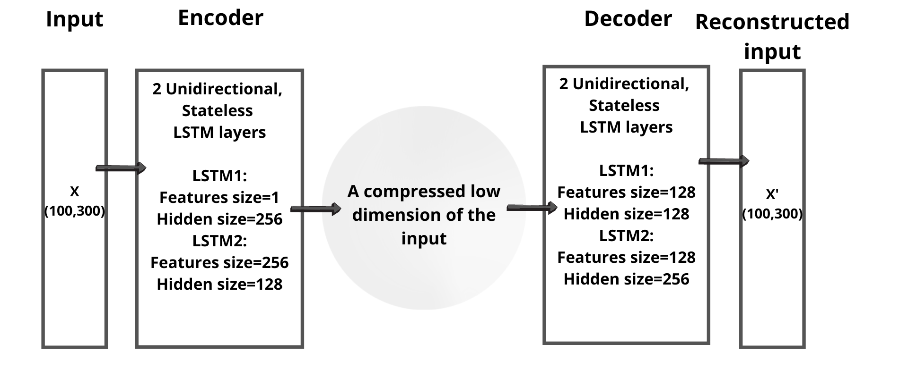
5. Experimental Results
LSTM autoencoder benchmark architecture and results comparison with HyRCoML topology
Fully trainable deep LSTM auto-encoder network
 | HyRCoML | LSTM
Mean accuracy | 0.903 | 0.648
Mean f1 score | 0.913 | 0.710
Mean training time (ms) | 2173.178 | 780285.313
Notes:
The achieved results on the HyRCoML were compared to the achieved results on the benchmark LSTM based autoencoder. The LSTM autoencoder is a deep fully trainable network, was trained on the same amount of input data. It gave an accuracy of 65% in average and f1 score of 71%. We can notice that HyRCoML results better in terms of accuracy and training time. In fact the training of the LSTM autoencoder takes in average 13 min while the proposed topology takes only 2 seconds to be trained on the same amount of data.

Slide 22
6
Complexity analysis
3
Notes:
Now we will take a look at the complexity of our system to see whether it is implementable or not on an MCU

Slide 23


6. Complexity analysis
Estimated complexity
Estimating the complexity on STM 32 of the HyRCoML network on inference and training process, based on the mathematical model behind each module.
Input memory for training task | 10.000 bytes= 60.000 / 6
Input memory for inference task | 600 bytes = 300 samples * 2 bytes
 | STM32 ARM Cortex M4 (80MHz) (cycles/macc = 9) | STM32 ARM Cortex M7 (480MHz) (cycles/macc = 6)
Mean training time (s) | 43.016 | 4.779
Mean inference time (s) | 0.471 | 0.052
Notes:
The complexity of the proposed network was estimated based on the mathematical model behind each module for inference and training process. To train the model, we need 13 seconds to acquire the data stream which size is 10kb. On a microcontroller, the training can run in less than 5 seconds at initialization time and achieves 19 inferences per second on STM32 M7 at 480MHz.
These results are convenient but can be improved and optimized in order to implement it on microcontrollers.

Slide 24
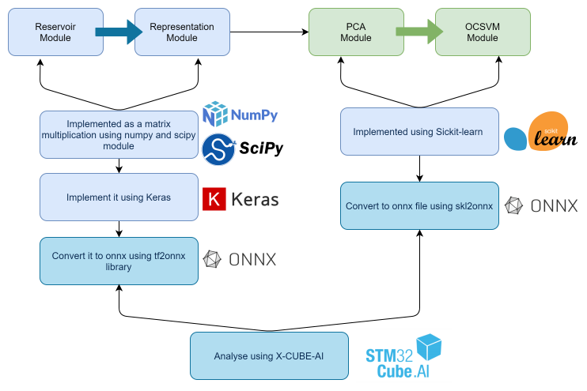
6. Complexity analysis
Complexity analysis using X-CUBE-AI
To use a tool for the complexity analysis would be a greater idea that gives more accurate calculation.
Notes:
The complexity of the network can also be analyzed using a tool in order to provide more accurate calculation. For this matter we can use XCUBE AI to analyze the complexity of the network. X-CUBE-AI offers several means to validate Artificial Intelligence algorithms as well as to measure performences on STM32 device.
The HyRCoML network can be devided into two dependent nmodels. On the right side we have the reservoir and the representation module that needs to be implemented as keras modules and then converted to onnx file so it can be analyzed by X-Cube-AI. And on the right side we have a pipeline composed by a PCA and OCSVM, both models were implemented using sickitlearn library and were converted into onnx file to be analyzed b X-CUBE-AI.

Slide 25
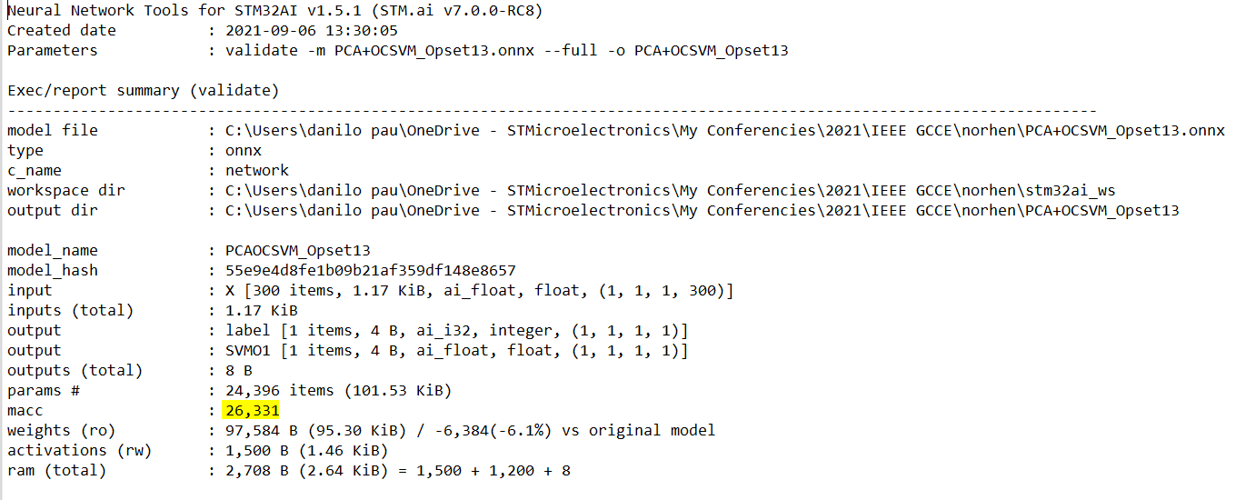

6. Complexity analysis
Complexity analysis using X-CUBE-AI
The estimated complexity for inference task is 27,090 MACC/s
Very close results!
Notes:
Here we can see the summary output of X-CUBE-AI for OCSVM and PCA. And we can notice that the complexity in terms of MACC is so close to the estimated complexity based on the mathematical models.

Slide 26
7
Conclusion & future work
3

Slide 27
7. Conclusion & future work
The reservoir combined with these machine learning modules achieve good performances both in terms of classification accuracy and execution time → This makes this work suitable for fast personalization and real-time embedded applications
Performing more tests using
different hyperparameters
1
2
Training OCSVM using batches
of windows
JavaScript
Explore reservoir properties like
bidirectionality, recurrency
3
4
Perform on STM32, measurements
of the Reservoir Keras model
Notes:
we proposed a bidirectional RC with one class classifier based on the recurrent reservoir model space representation, which can use a limited and fixed
amount of normal data to perform real-time anomaly detection on time series ECG data generated by a sliding window. We concluded that recurrent reservoir networks combined
with these machine learning modules achieve better performances both in terms of classification accuracy and execution time, that is competitive to those obtained by more complex models, while requiring only a few seconds to be trained online. This makes this work suitable for fast personalization and real-time embedded applications
In the future work, we consider performing more tests using different hyperparameters, we also want to train the OCSVM using batches of data instead of feeding the network at once.
Finally we will perform more STM measurements of the reservoir implemented with keras library.

Slide 28
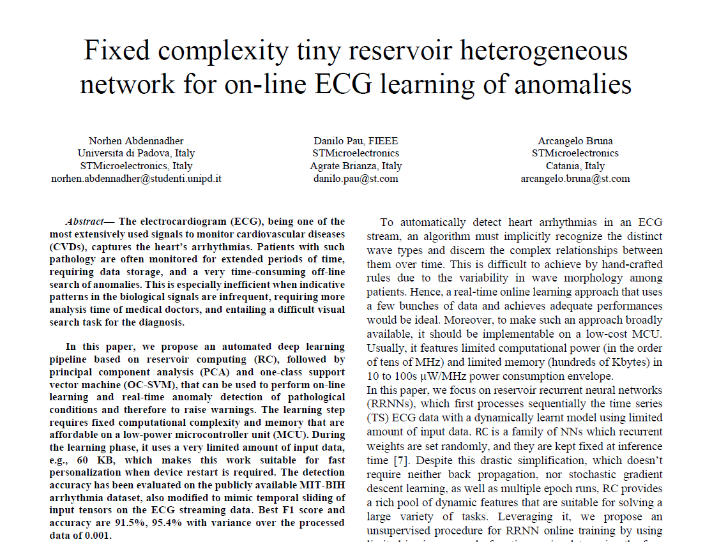
7. Conclusion & future work
IEEE GCCE paper accepted, To be presented on Oct 12, 2021

Slide 29

THANK YOU FOR
YOUR ATTENTION
.

